Slide 1
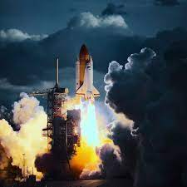
Data Science Capstone Project: SPACEX
By
Sayeda Fatima

Slide 2



Outline
Executive Summary
Introduction
Methodology
Results
Conclusion
Appendix

Slide 3




Executive Summary
With PowerPoint, you can create presentations and share your work with others, wherever they are. Type the text you want here to get started. You can also add images, art, and videos on this template. Save to OneDrive and access your presentations from your computer, tablet, or phone.

Slide 4

Project Background and Context
The aim of this project is to predict if the Falcon 9 first stage will successfullyland.SpaceX says on its website that the Falcon 9rocket launch cost 62 million dollars. Other providers cost upward of 165 million dollars each. The price difference is explained by the fact that SpaceX can reuse the first stage. By determining if the stage will land, we can determine the cost of a launch. This information is interesting for another company if it wants to compete with SpaceX for a rocket launch.
Problems you want to find answers
What are the main characteristics of a successful or failed landing ?
What are the effects of each relationship of the rocket variables on the success or failure of a landing ?
What are the conditions which will allow SpaceX to achieve the best landing success rate ?

Slide 5


Data Collection
SPACE X Rest API
Data Wrangling
Unwanted Column Drop
One-Hot Coding
Exploratory Data Analysis
Visualizations
SQL
Interactive Visual Analytics
Folium
Plotly Dash
Predictive Analysis
Classification Models

Slide 6
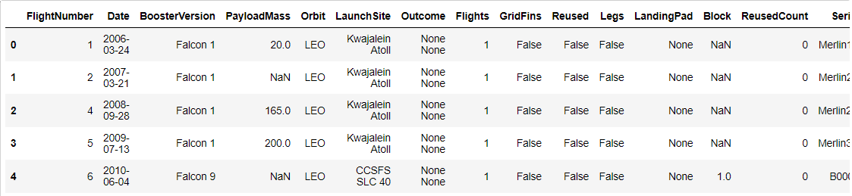
Data Collection Methods
API Data Extraction
Importing json file from: "https://api.spacexdata.com/v4/launches/past"
Pandas Data Transformation
Importing selected columns from
Data Filteration
Filtering ‘Falcon9’ rows
json data into pandas dataframe

Slide 7
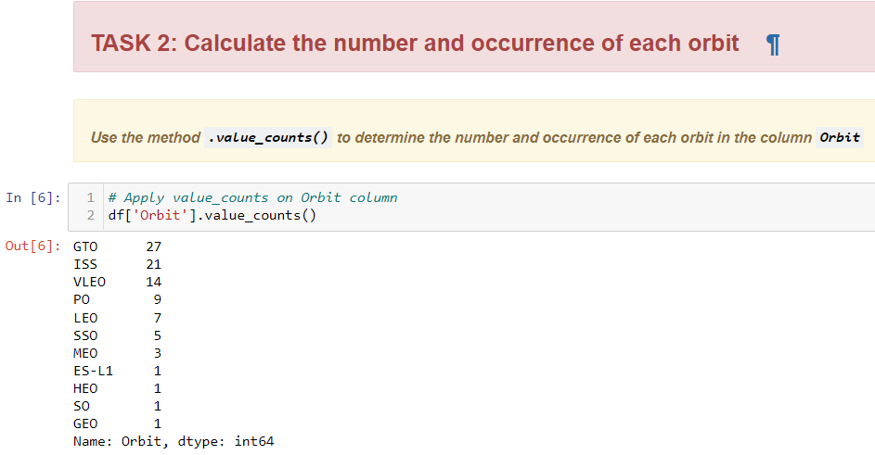
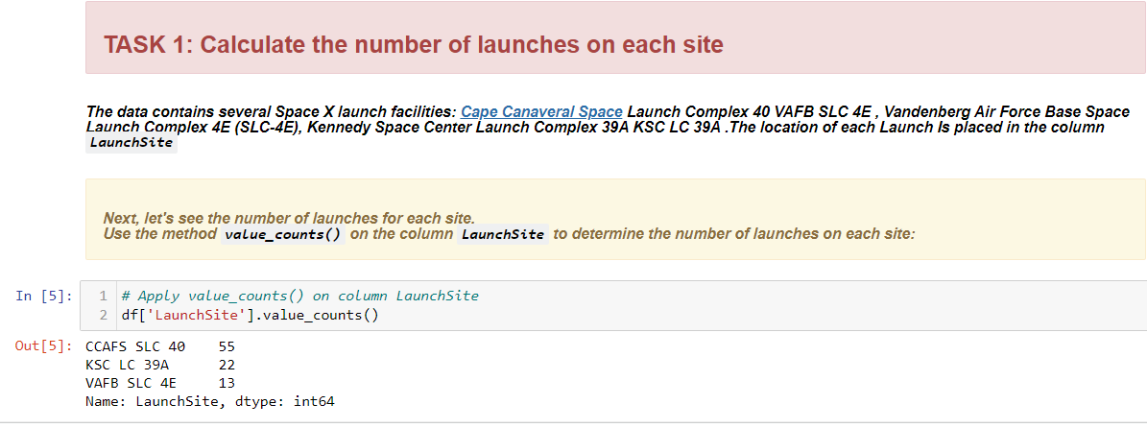
Data Wrangling Methods 1
Data Analysis
Task 1: Calculating “Number of Launches“
Data Upload
“csv” to Dataframe
Task 2: Calculating “Orbit Occurrences“

Slide 8
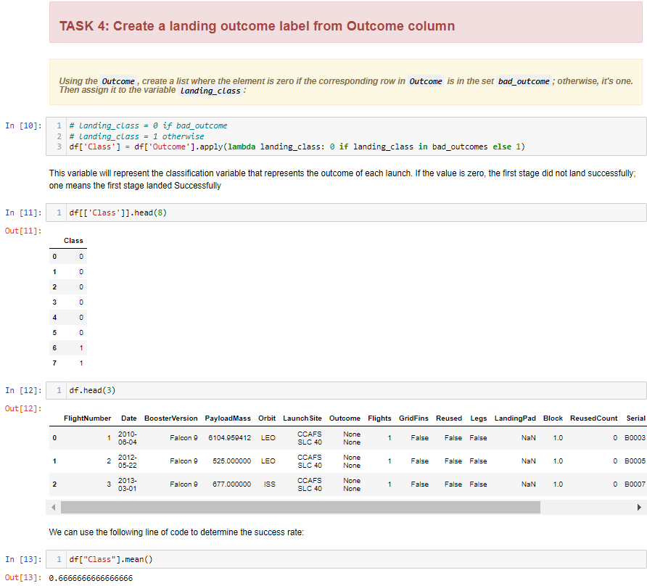
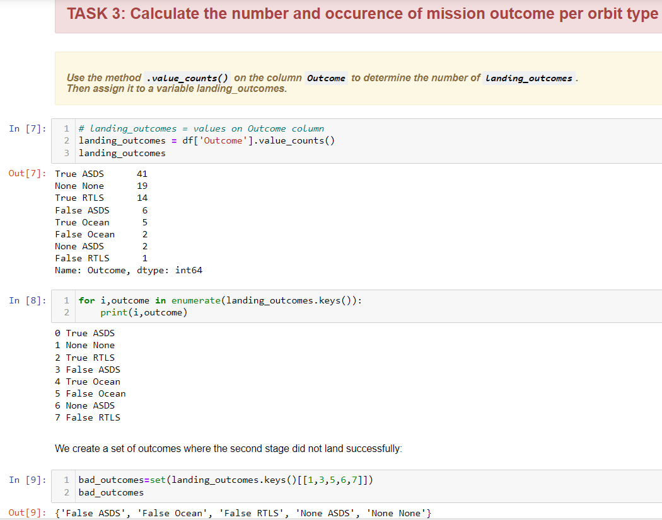
Data Wrangling Methods 2
Task 4: Creating “Landing Outcome Label“
Task 3: Calculating Mission Outcome Occurrences“
Data Analysis

Slide 9
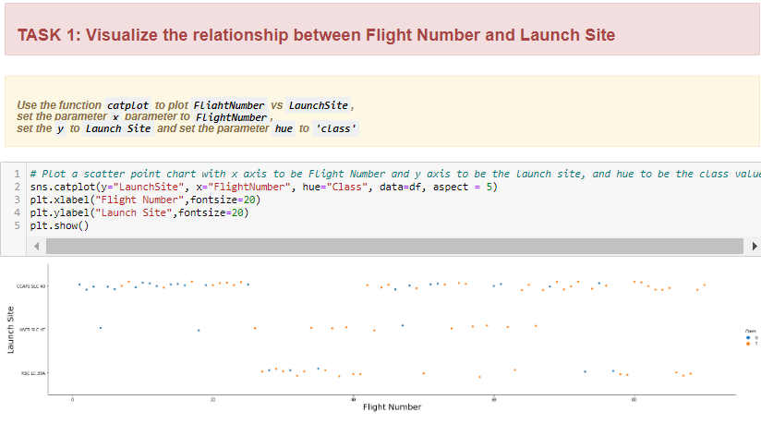
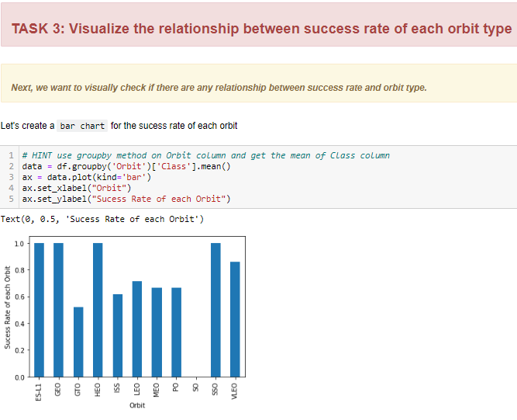
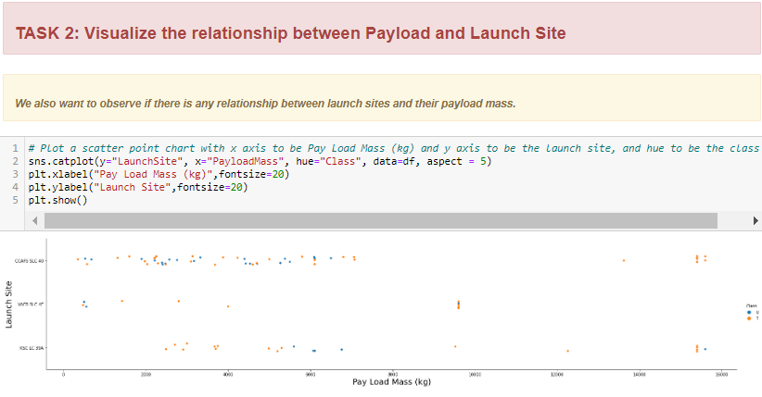
EDA Interactive Visuals Results 1
Tasks
Task 1: “Flight Number” & “Launch Site”
Task 2: “Payload Mass” & “Launch Site”
Task 3: “Success Rate” & “Orbit Type”

Slide 10
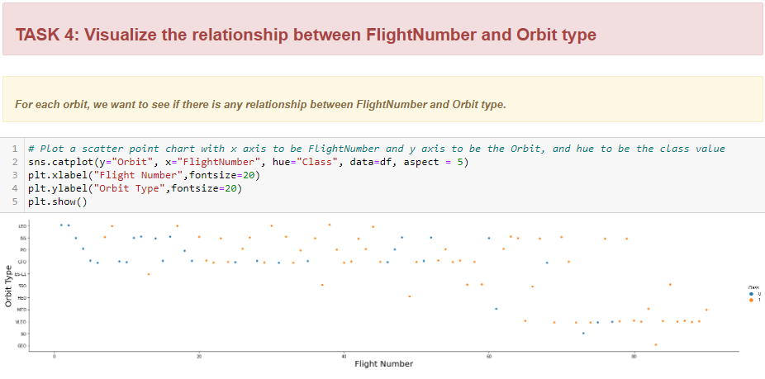
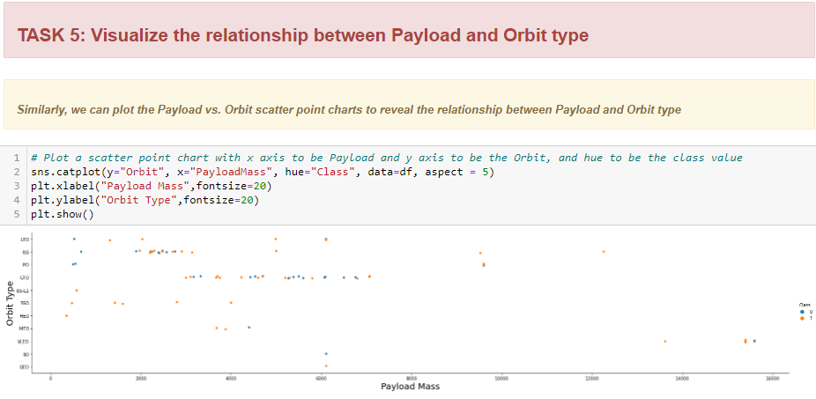
EDA Interactive Visuals Results 2
Tasks
Task 4: “Flight Number” & “Orbit Type”
Task 5: “Payload Mass” & “Orbit Type”

Slide 11
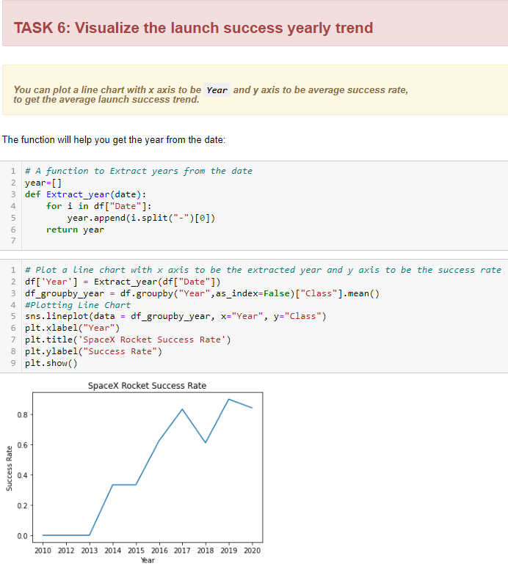
EDA Interactive Visuals Results 3
Tasks
Task 6: Launch Site“Yearly Trend”

Slide 12
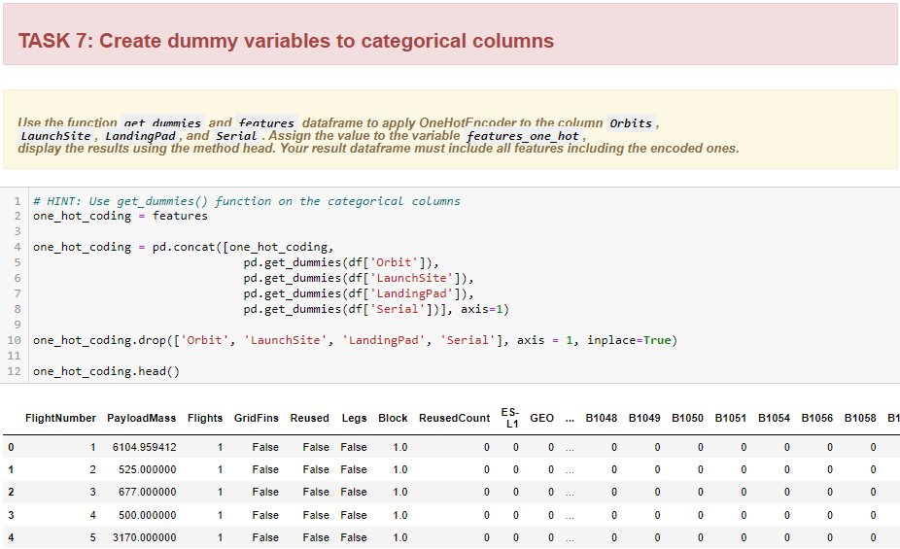
EDA Interactive Visuals Results 4
Tasks
Task 7: Launch Site
“One Hot Coding”

Slide 13
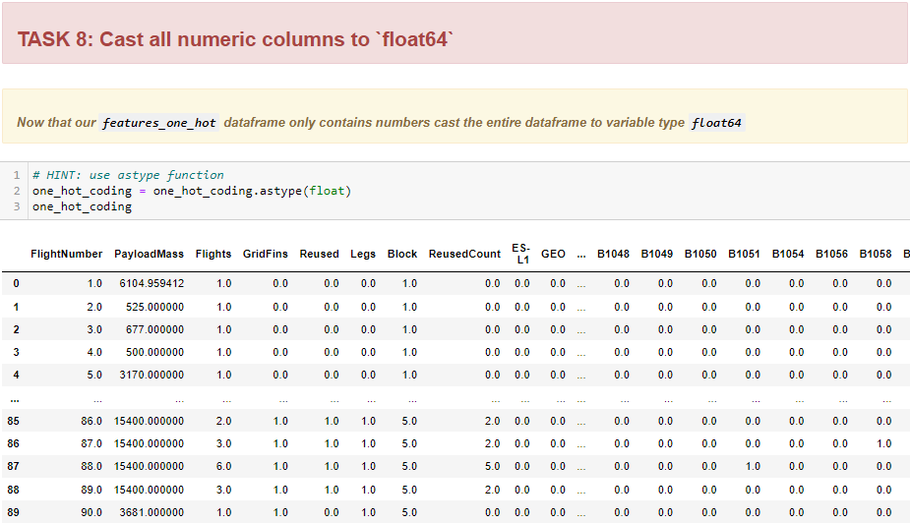
EDA Interactive Visuals Results 5
Tasks
Task 8: “One Hot Coding” Results

Slide 14
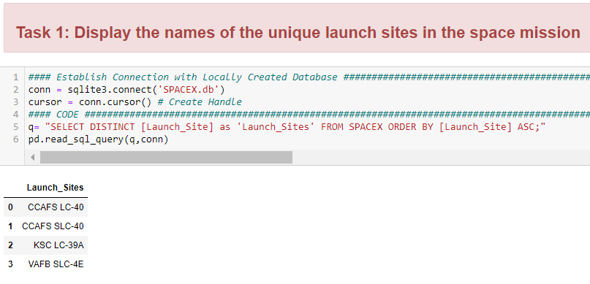
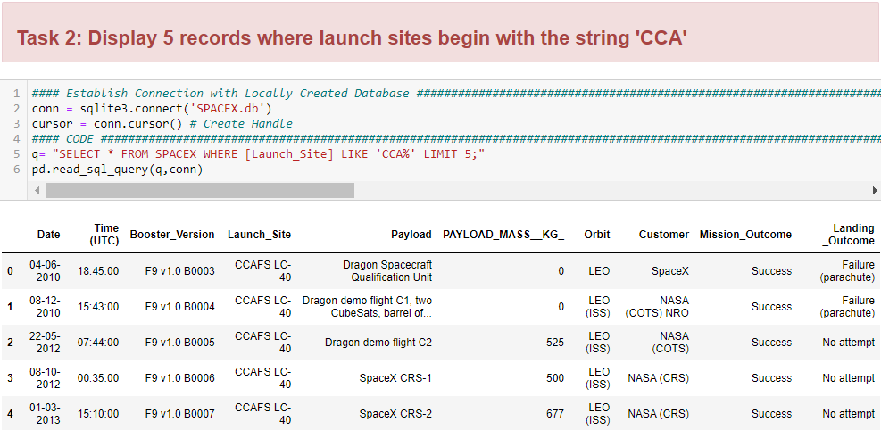
Exploratory Data Analysis with SQL 1
Bonus Task
Local SQL Database Creation from csv
Tasks
Task 1: Unique Launch Sites
Task 2: Records of Launch Sites Like ‘CCA’

Slide 15
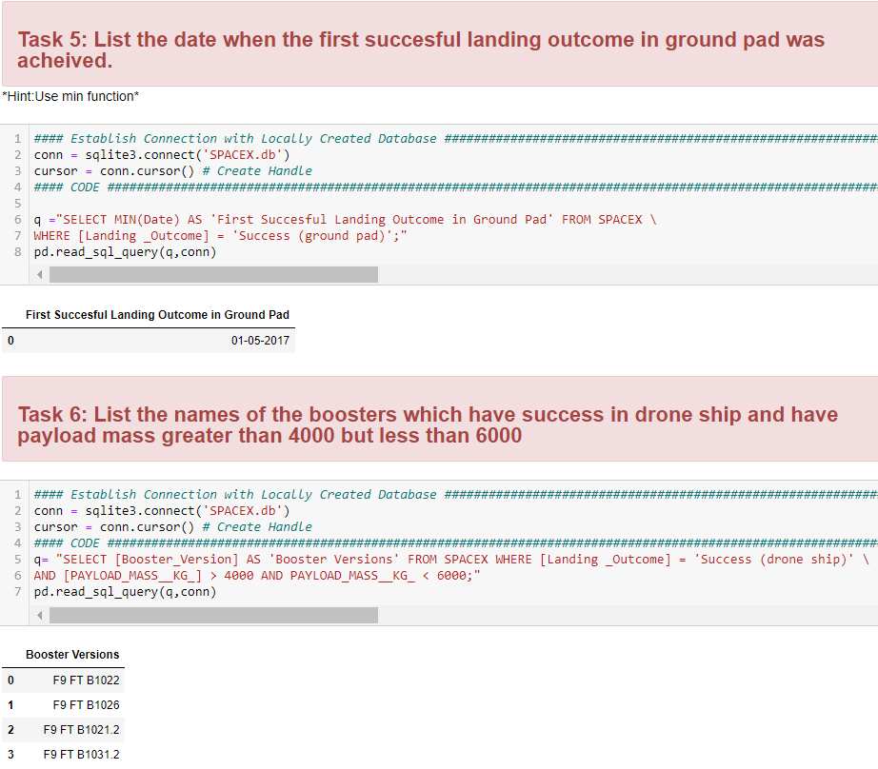
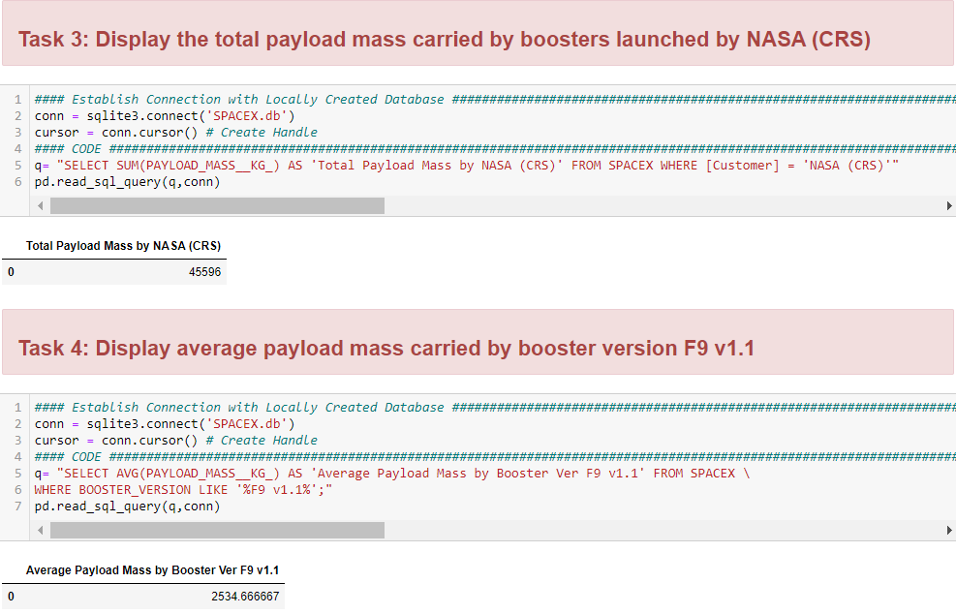
Exploratory Data Analysis with SQL 2
Tasks
Task 3: Total “Payload Mass” by Booster
Task 4: Average “Payload Mass” by Booster
Task 5: First Successful Landing
Task 6: Boosters with Drone Ship Success

Slide 16
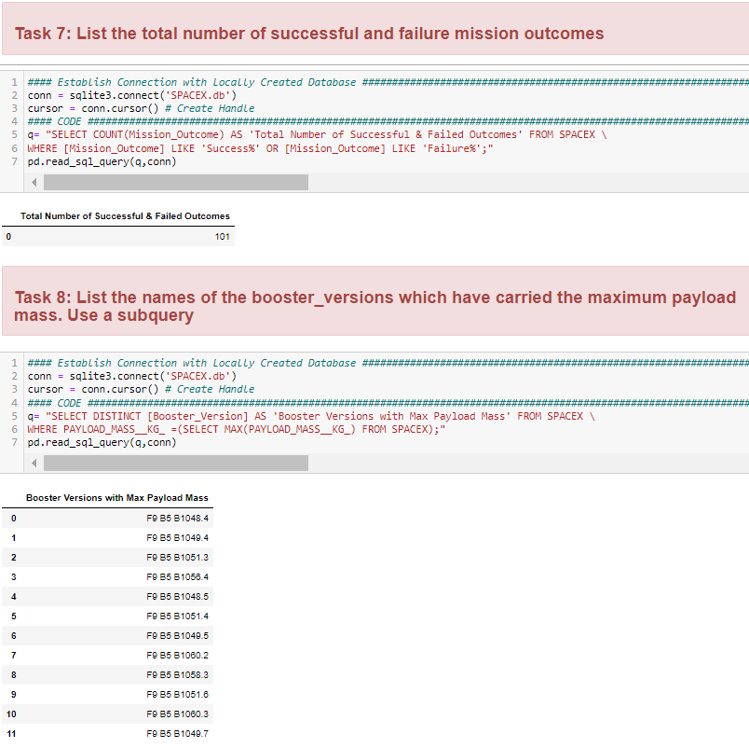
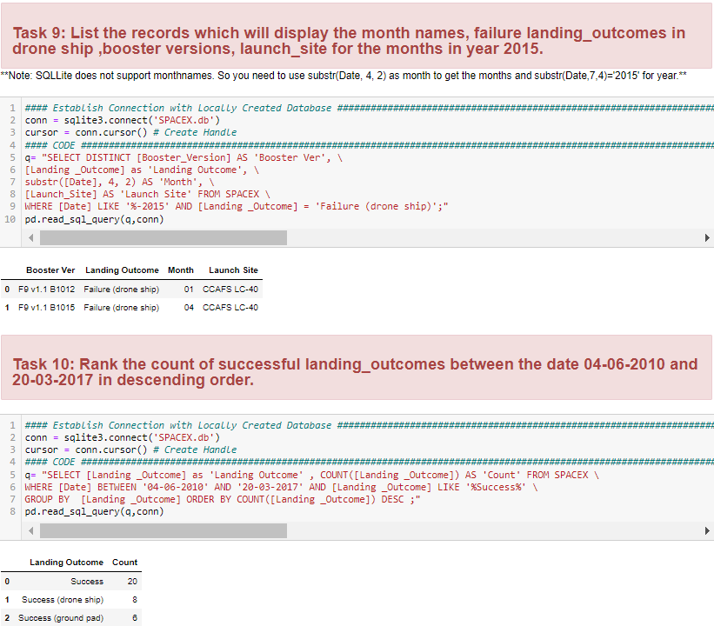
Exploratory Data Analysis with SQL 3
Tasks
Task 7: Total Successful & Failed Outcomes
Task 8: Boosters with Max “Payload Mass”
Task 9: “Year 2015” Analysis
Task 10: Analysis between “2010-17”

Slide 17
Interactive Visual Analysis Methods
Folium
US States with SPACEX
Plotly Dash
Importing selected columns from json data into pandas dataframe

Slide 18
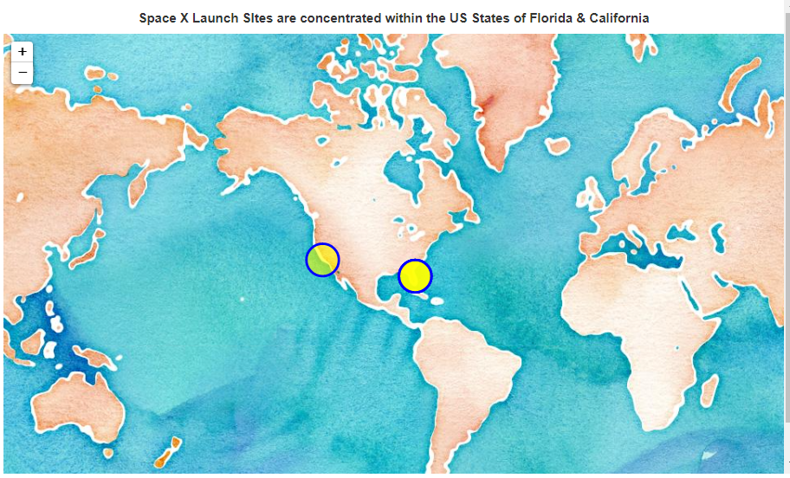
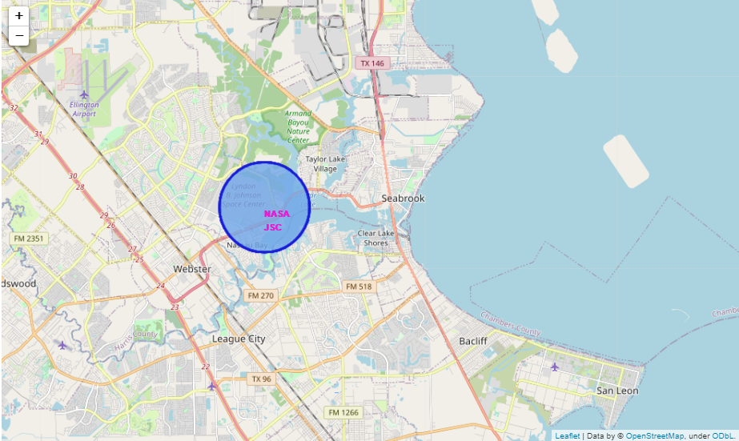
Interactive Visual Analysis
Folium Results 1
Bonus Task: Displaying Concentration of Space X Launch Sites
Task 1: Displaying 'NASA Johnson Space Center'

Slide 19
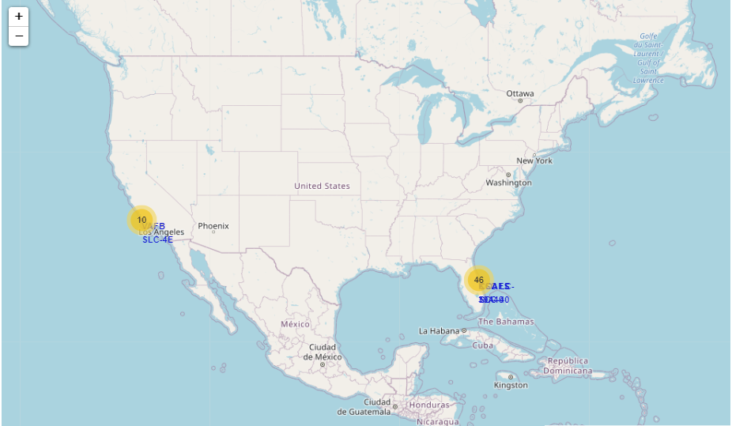
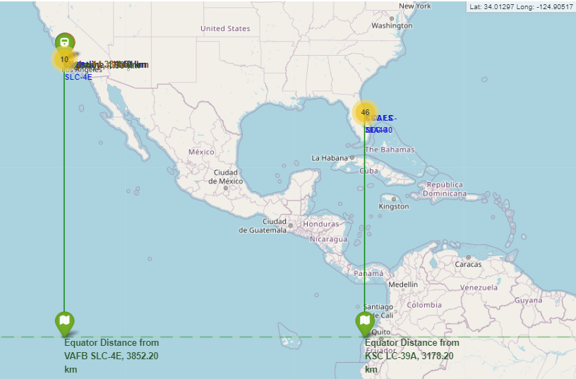
Interactive Visual Analysis
Folium Results 2
Task 2: Displaying Successful/Failed Launches
Task 3: Displaying Distances between Launch Sites to its Proximities

Slide 20
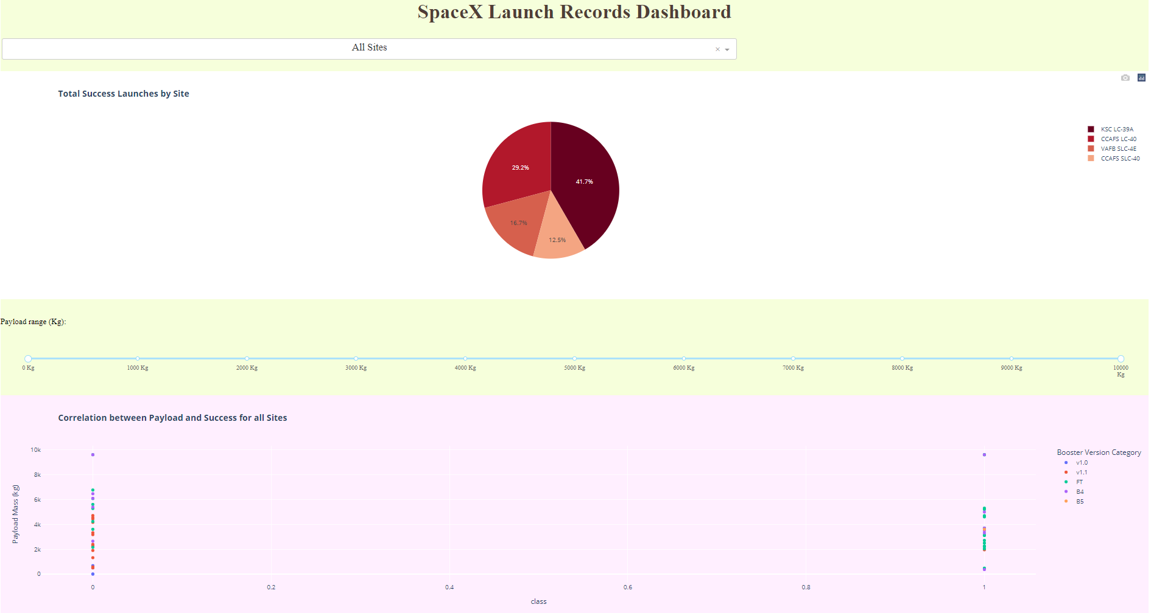
Interactive Visual Analysis: Plotly Dash All Sites Results

Slide 21
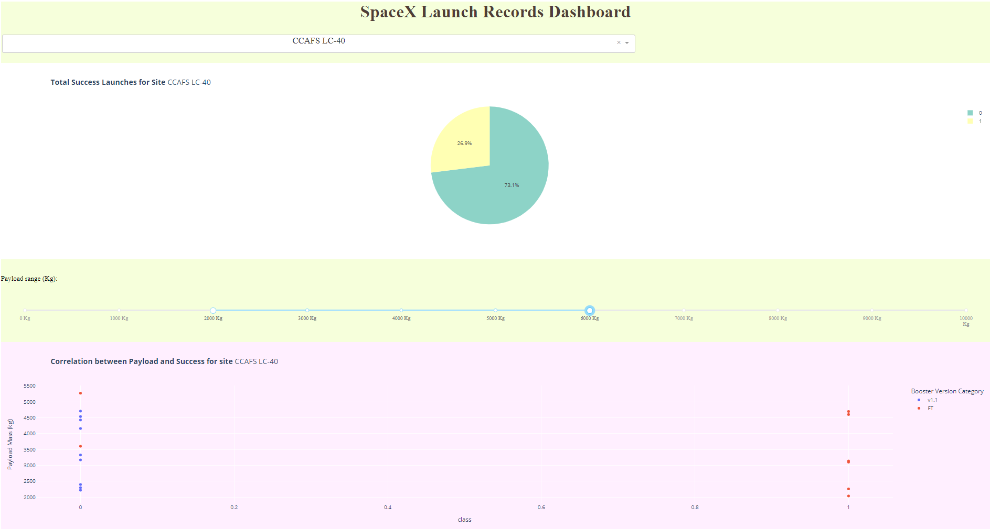
Interactive Visual Analysis: Plotly Dash Selected Site Results

Slide 22
Predictive Analysis Methods
API Data Extraction
Importing json file from: "https://api.spacexdata.com/v4/launches/past"
Pandas Data Transformation
Importing selected columns from json data into pandas dataframe
Data Filteration
Filtering ‘Falcon9’ rows

Slide 23

The way to get started is to quit talking and begin doing.
Walt Disney

Slide 24




Team
Name
Name
Name
Name
Title
Title
Title
Title

Slide 25
Timeline
Title
To start a presentation, go to the Slide Show tab, and select From Beginning.
Title
To display Presenter view, in Slide Show view, on the control bar at the bottom left select the three dots, and then Show Presenter View.
Title
During your presentation, the speaker notes are visible on your monitor, but aren't visible to the audience.
Title
Title
If you don’t see the Notes pane or it is completely minimized, click Notes on the task bar across the bottom of the PowerPoint window.
The Notes pane is a box that appears below each slide. Tap it to add notes.

Slide 26
Results
Subtitle

Slide 27
Content
Subtitle
Subtitle
Add text, images, art, and videos.
Add transitions, animations, and motion.
Save to OneDrive, to get to your presentations from your computer, tablet, or phone.
Open the Design Ideas pane for instant slide makeovers.
When we have design ideas, we’ll show them to you right there.

Slide 28
Content 2
Subtitle
subtitle
subtitle
Add text, images, art, and videos.
Add transitions, animations, and motion.
Save to OneDrive, to get to your presentations from your computer, tablet, or phone.
Open the Design Ideas pane for instant slide makeovers.
When we have design ideas, we’ll show them to you right there.
Add text, images, art, and videos.
Add transitions, animations, and motion.
Save to OneDrive, to get to your presentations from your computer, tablet, or phone.
Open the Design Ideas pane for instant slide makeovers.
When we have design ideas, we’ll show them to you right there.
Add text, images, art, and videos.
Add transitions, animations, and motion.
Save to OneDrive, to get to your presentations from your computer, tablet, or phone.
Open the Design Ideas pane for instant slide makeovers.
When we have design ideas, we’ll show them to you right there.

Slide 29

Conclusion
With PowerPoint, you can create presentations and share your work with others, wherever they are. Type the text you want here to get started. You can also add images, art, and videos on this template. Save to OneDrive and access your presentations from your computer, tablet, or phone.

Slide 30


Thank You
Sayeda Fatima
Email address
Website address

